Slide 1

Voice-Based Gender Identification
Mini Project Presentation
5th semester 2022-23
by
Neha Kumari
University Roll no:2016870
Mentor : Mr. Ankit Gupta(Assnt. Professor)
Department of Computer Science and Engineering
Graphic Era (Deemed to be University)
Dehradun, Uttarakhand
January 2023

Slide 2
PROBLEM STATEMENT
Project on Voice Based Gender Identification.
OBJECTIVE
- Classifying a person’s gender based upon his/her acoustic properties of voice.
- Machine learning classification techniques can be used on these type of problem statements.
- The learning used here should be supervised learning as we know the actual output and we can compare the predictions with it.

Slide 3
INTRODUCTION
Gender voice is considered one of the pivotal parts to be detected from given voice, a task that involves certain complications.
In order to distinguish gender from a voice signal, a set of technique have been employed to determine relevant features to be utilized for building a model from a training set.
This model is useful for determining the gender (i.e., male or female) from a voice signals.

Slide 4
TECHNIQUES AND TECHNOLOGIES USED:
Jupyter notebook used for implementation.
Machine learning library sklearn used with many subordinate models such as model_selection, classifiers, and metrics etc.
Data set available on Kaggle.
Data science libraries such as pandas, matplotlib, seaborn, numpy etc.
HOW THE DATASET LOOK LIKE?
Dataset Name - Gender Recognition by Voice Dataset Kaggle
Dataset Link - https://www.kaggle.com/datasets/primaryobjects/voicegender

Slide 5
METHODOLOGY
Classification Model
Decision Tree Model
It is one the classification techniques used in data mining and machine learning where decision trees are constructed via algorithmic approach that identifies ways to split a data set based on different conditions.
Random Forest Model
Random Forest is an ensemble technique capable of performing both regression and classification tasks. It combines hundreds or thousands of decisions trees, trains each one on a slightly different set of the observations.
Support Vector Machine(SVM)
Support Vector Machine” (SVM) is a supervised algo that can be used for both classification or regression challenges. However, it is mostly used in classification problems.

Slide 6
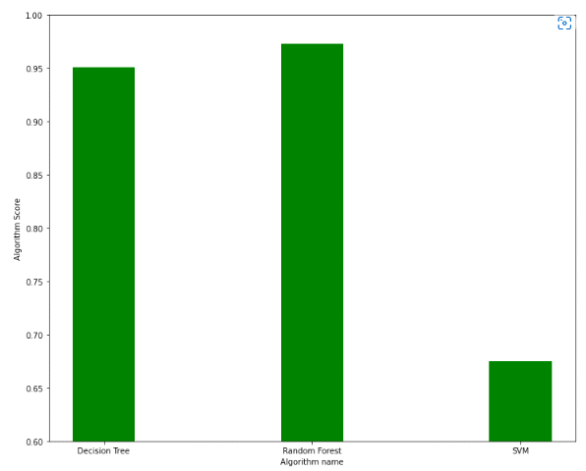
CLASSIFICATION SCORE BAR CHART–

Slide 7
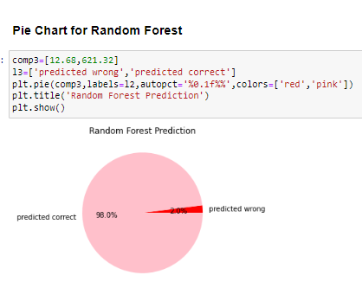
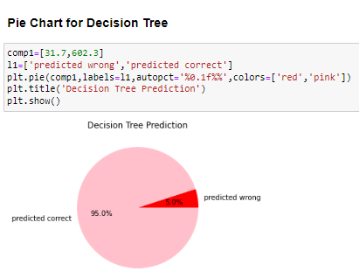
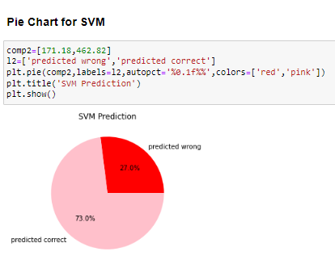
PIE CHART FOR MODEL PREDICTIONS–

Slide 8
Result and Discussion
In the project, it is clear that our model works well on recognizing whether a person is male or female with a high accuracy of about 98% using Random Forest model.
Using other model such as Decision tree and Support vector machine we got accuracy of 95% and 73% respectively.
Based on precision, F1-Score, Recall Values, prediction pie chart, Accuracy Score, confusion matrix, ROC curve and AUC line graph,
we can say that Random Forest Classification is best suited for this problem where we are Predicting the person as male/female based upon they voice signals.
Support Vector machine is least suitable based on same analysis.

Slide 9
ACCURACY-
Accuracy for decision tree model is: - 95%
Accuracy for Support vector machine model is: - 73%
Accuracy for Random Forest model is: - 98%

Slide 10
CONCLUSION
Random Forest model itself is a super accurate model, and hence has more potentials than the other model in the voice-based gender classification, and possibly in other classification applications.
For text dependent type of classification, the SVM could be the best choice.
For text independent type of classification, the Random Forest is one of the choices.

Slide 11
FUTURE WORK
Investigate the reasons why such a super SVM model can’t perform well for the text independent gender classification.
Explore the possible voice features which might improve the SVM text independent classification performance.
It could be meaningful to compare SVM performance with other classification model.
Examine SVM model for other voice based classification applications, such as age and spoken language.

